Slide 1
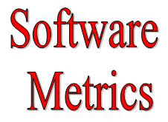
Compiled by
Dr Arun Sharma

Slide 2
Questions
How big is the program?
  Huge!!
How close are you to finishing?
  We are almost there!!
Can you, as a manager, make any useful decisions from such subjective information?
Need information like, cost, effort, size of project.

Slide 3
Definitions
Measure - quantitative indication of extent, amount, dimension, capacity, or size of some attribute of a product or process.
  E.g., Number of errors
Metric - quantitative measure of degree to which a system, component or process possesses a given attribute. “A handle or guess about a given attribute.”
  E.g., Error rates

Slide 4
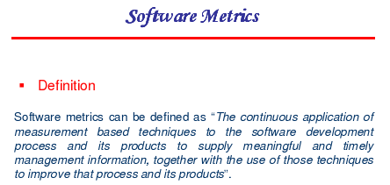

Slide 5
Why Measure Software?
You cannot manage internally what you do not measure
Approximately 40% of all projects fail due to lack of management control (Coopers & Lybrand – Sept. 1995)
Measurement gives you a tool to communicate to your customers the size of their request, and extrapolate productivity, quality and estimating accuracy
Many competitors may already have these insights
You measure to understand and improve your processes

Slide 6
Motivation for Metrics
Estimate the cost & schedule of future projects
Evaluate the productivity impacts of new tools and techniques
Establish productivity trends over time
Improve software quality
Forecast future staffing needs
Anticipate and reduce future maintenance needs

Slide 7
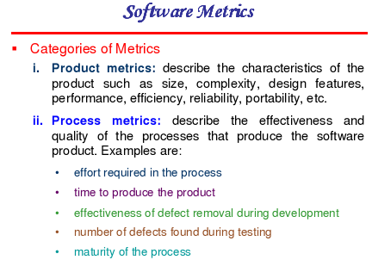

Slide 8
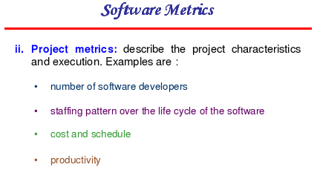

Slide 9
Types of Measures
Direct Measures (internal attributes)
  Cost, effort, LOC, speed, memory
Indirect Measures (external attributes)
  Functionality, quality, complexity, efficiency, reliability, maintainability

Slide 10
Size-Oriented Metrics
Size of the software produced
LOC - Lines Of Code
KLOC - 1000 Lines Of Code
SLOC – Statement Lines of Code (ignore whitespace)
Typical Measures:
  Errors/KLOC, Defects/KLOC, Cost/LOC, Documentation Pages/KLOC

Slide 11
LOC Metrics
Easy to use
Easy to compute
Language & programmer dependent

Slide 12
Complexity Metrics
Halstead’s Software Science measures
  n₁ - number of distinct operators
  n₂ - number of distinct operands
  N₁ - total number of operators
  N₂ - total number of operands

Slide 13
Example
if (k < 2)
{
if (k > 3)
x = x*k;
}
Distinct operators: if ( ) { } > < = * ;
Distinct operands: k 2 3 x
n₁ = 10
n₂ = 4
N₁ = 13
N₂ = 7

Slide 14
Halstead’s Metrics
Program length: N = N₁ + N₂
Program vocabulary: n = n₁ + n₂
Estimated length: = n₁ log₂ n₁ + n₂ log₂ n₂
  Close estimate of length for well structured programs

Slide 15

Program Complexity
Volume: V = N log₂ n
  Number of bits to provide a unique designator for each of the n items in the program vocabulary.
Difficulty
Program effort: E=D*V
  This is a good measure of program understandability

Slide 16
Example of program length
n
=
9
(if,
<,
=,-
(sign),
while,
1
if (y < 0)
pow = - y;
else
pow = y;
z = 1.0;
while (pow != 0) {
z = z * x;
pow = pow - 1;
}
if (y < 0)
z = 1.0 / z;
!
=,
*,
-
(minus),
/)
n
=
7
(y,
0,
pow,
z,
x,
1,
1.0)
2
Est. Length
=
9
log
9
+
7
log
7
≈
48
2
2

Slide 17
Example of program length
n
=
9
(for,
=,
<,
+
+,
-,
+,
[],
>,
if)
for ( j=1; j<N; j++) {
last = N - j + 1;
for (k=1; k <last; k ++) {
if (list[k] > list[k+1]) {
temp = list[k];
list[k] = list[k+1];
list[k+1] = temp;
}
}
}
1
n
=
7
(j,
1,
N,
last,
k,
list,
temp)
2
Est. Length
=
9
log
9
+
7
log
7
≈
48
2
2

Slide 18
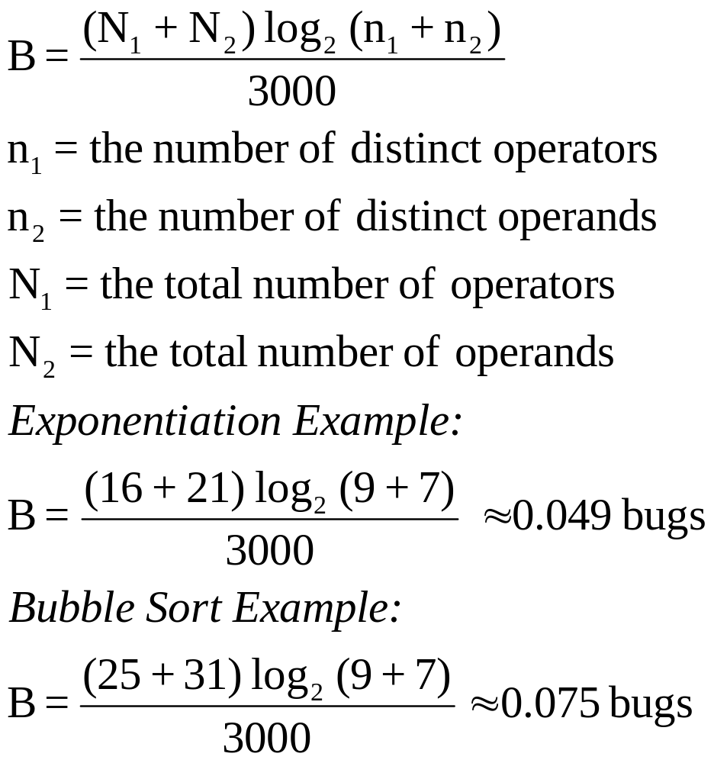
Halstead’s bug prediction

Slide 19
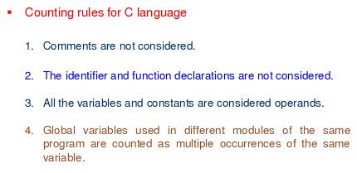
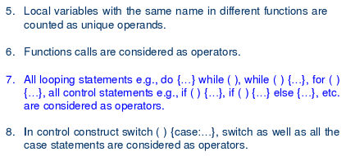
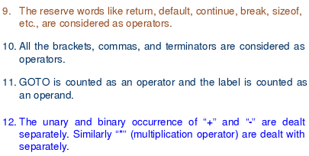

Slide 20
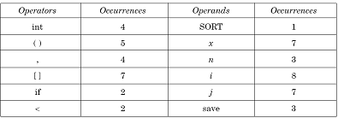
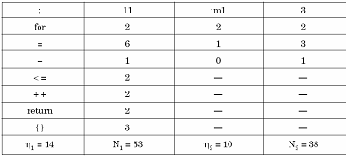
Example

Slide 21
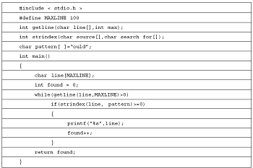
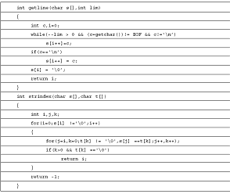
Example

Slide 22
Find Efforts by using Halstead Metric and Cyclomatic complexity
      i=2;
      j=3;
      k=i*j;
      if (k>5)
      {
      k=5;
      }

Slide 23
How good are Halstead’s metrics?
The validity of the metric has been confirmed experimentally many times, independently, over a wide range of programs and languages.
Lipow compared actual to predicted bug counts to within 8% over a range of program sizes from 300 to 12,000 statements.

Slide 24
McCabe’s Complexity Measures
McCabe’s metrics are based on a control flow representation of the program.
A program graph is used to depict control flow.
Nodes represent processing tasks (one or more code statements)
Edges represent control flow between nodes

Slide 25
Flow Graph Notation
While
Sequence
If-then-else
Until

Slide 26
Cyclomatic Complexity
Set of independent paths through the graph (basis set)
V(G) = E – N + 2
  E is the number of flow graph edges
  N is the number of nodes

Slide 27
Mccabe’s Cyclomatic Complexity
Number of independent test paths=edges-nodes+2
1-2+2=1
4-4+2=2
3-3+2=2
Straight line
code
if-then-else
while-do

Slide 28
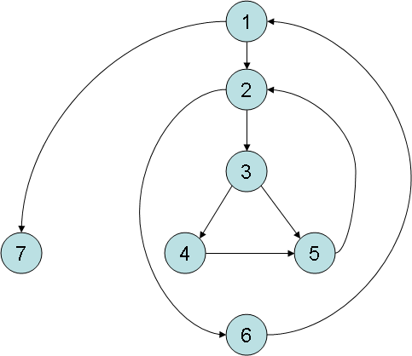
Example
i = 0;
while (i<n-1) do
j = i + 1;
while (j<n) do
if A[i]<A[j] then
swap(A[i], A[j]);
end do;
i=i+1;
end do;
Flow Graph

Slide 29
Computing V(G)
V(G) = 9 – 7 + 2 = 4
V(G) = 3 + 1 = 4
Basis Set
  1, 7
  1, 2, 6, 1, 7
  1, 2, 3, 4, 5, 2, 6, 1, 7
  1, 2, 3, 5, 2, 6, 1, 7

Slide 30
Examples of cyclomatic complexity
L=1, N=2, P=1
M=1-2+2=1
L=4, N=4, P=1
M=4-4+2=2
L=2, N=4, P=2
M=2-4+4=2
L=4, N=5, P=1
M=4-5+2=1

Slide 31
What is the complexity?
public void howComplex() {
int i=20;
while (i<10) {
System.out.printf("i is %d", i);
if (i%2 == 0) {
System.out.println("even");
} else {
System.out.println("odd");
}
}
}

Slide 32
What is the complexity V(G)?
public void howComplex() {
int i=20;
while (i<10) {
System.out.printf("i is %d", i);
if (i%2 == 0) {
System.out.println("even");
} else {
System.out.println("odd");
}
}
}
V(G) = 2 enclosed area + 1 = 3

Slide 33
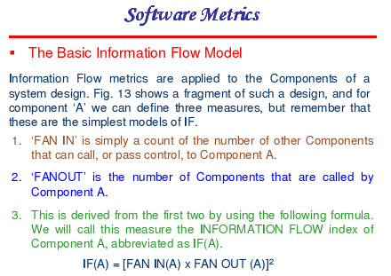

Slide 34
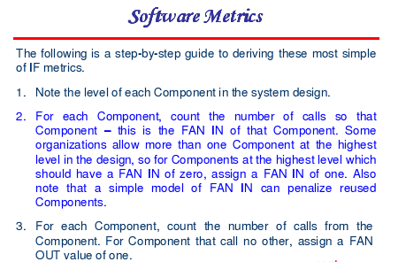

Slide 35
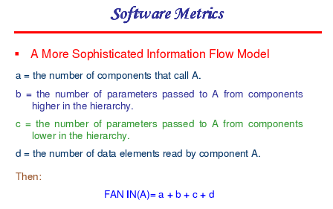

Slide 36
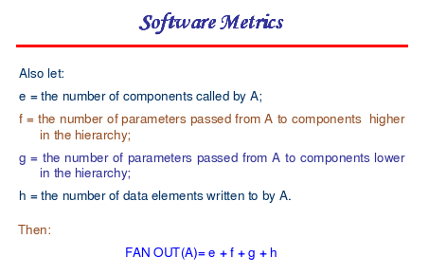

Slide 37
Problems with Lines of Code Metrics
Lack of a universally accepted definition for exactly what a line of code is.
Language dependence (high-level versus low-level programming languages).
It is difficult to estimate the number of lines of code that will be needed to develop a system from information that is available in analysis and design phases.
Lines of code places all emphasis on coding, which is only part of the implementation phase of a software development project.

Slide 38
Function Point Analysis
What is Function Point Analysis (FPA)?
It is designed to estimate and measure the time, and thereby the cost, of developing new software applications and maintaining existing software applications.
It is also useful in comparing and highlighting opportunities for productivity improvements in software development.
It was developed by A.J. Albrecht of the IBM Corporation in the early 1980s.
The main other approach used for measuring the size, and therefore the time required, of software project is lines of code (LOC) – which has a number of inherent problems.

Slide 39
What Are Function Points?
Function Points measure software size by quantifying the functionality provided to the user based solely on logical design and functional specifications
Function point analysis is a method of quantifying the size and complexity of a software system in terms of the functions that the system delivers to the user
It is independent of the computer language, development methodology, technology or capability of the project team used to develop the application

Slide 40
Function Point Analysis
How is Function Point Analysis done?
Working from the project design specifications, the
following system functions are measured (counted):
Inputs
Outputs
Files
Inquires
Interfaces

Slide 41
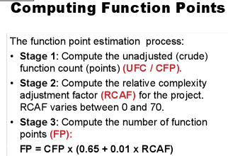

Slide 42
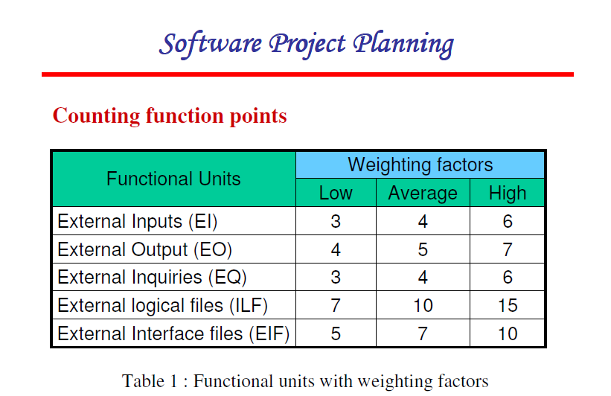

Slide 43
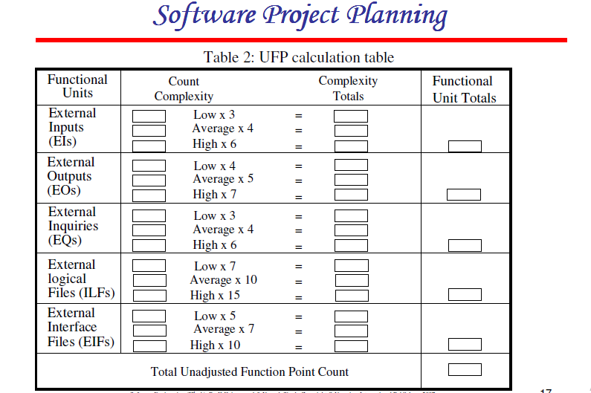

Slide 44
Function Point Analysis
A simple example:
inputs
3 simple X 2 = 6
4 average X 4 = 16
1 complex X 6 = 6
outputs
6 average X 5 = 30
2 complex X 7 = 14
files
5 complex X 15 = 75
inquiries
8 average X 4 = 32
interfaces
3 average X 7 = 21
4 complex X 10 = 40
Unadjusted function points 240

Slide 45
Function Point Analysis
In addition to these individually weighted function points, there are factors that affect the project and/or system as a whole. There are number (~35) of these factors that affect the size of the project effort, and each is ranked from “0”- no influence to “5”- essential.
The following are some examples of these factors:
Back up and Recovery Data Communication Distributed Processing Critical Performance Heavily Used Configuration Online data Entry Transactional Complexity | Online Master File updation Complex External Processing Complex Internal Processing Reusability Installation Factor Multiple sites Change Facilitation

Slide 46
Function Point Analysis
Continuing our example . . .
Complex internal processing = 3
Code to be reusable = 2
High performance = 4
Multiple sites = 3
Distributed processing = 5
Project adjustment factor = 17
Adjustment calculation:
Adjusted FP = Unadjusted FP X [0.65 + (adjustment factor X 0.01)]
= 240 X [0.65 + ( 17 X 0.01)]
= 240 X [0.82]
= 197 Adjusted function points

Slide 47
Function Point Analysis
But how long will the project take and how much will it cost?
As previously measured, programmers in our organization average 18 function points per month. Thus . . .
197 FP divided by 18 = 11 man-months
If the average programmer is paid $5,200 per month (including benefits), then the [labor] cost of the project will be . . .
11 man-months X $5,200 = $57,200

Slide 48
Function Point Analysis
Because function point analysis is independent of language used, development platform, etc. it can be used to identify the productivity benefits of . . .
One programming language over another
One development platform over another
One development methodology over another
One programming department over another
Before-and-after gains in investing in programmer training
And so forth . . .

Slide 49
Function Point Analysis
But there are problems and criticisms:
Function point counts are affected by project size
Difficult to apply to massively distributed systems or to systems with very complex internal processing
Difficult to define logical files from physical files
The validity of the weights that Albrecht established – and the consistency of their application – has been challenged
Different companies will calculate function points slightly different, making inter-company comparisons questionable

Slide 50
Exercise
From a Data Entry Project, following details have been extracted. There is a need of 7 inputs, 10 outputs , 6 inquiries, 17 files and 4 external interfaces. Also, assume input and external interface function point attributes are of average complexity and all other function point attributes of low complexity. It wants a reliable back up, a highly reliable data communication, heavy transactional capability, online updation. All other elements are at minimal level. Find out Function Point Estimation for this.

Slide 51
Metrics for the Object Oriented
Chidamber & Kemerer ’94 TSE 20(6)
Metrics specifically designed to address object oriented software
Class oriented metrics
Direct measures

Slide 52
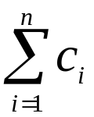
Weighted Methods per Class
WMC =
c_{i} is the complexity (e.g., volume, cyclomatic complexity, etc.) of each method
Viewpoints: (of Chidamber and Kemerer)
-The number of methods and complexity of methods is an indicator of how much time and effort is required to develop and maintain the object
-The larger the number of methods in an object, the greater the potential impact on the children
-Objects with large number of methods are likely to be more application specific, limiting the possible reuse

Slide 53
Depth of Inheritance Tree
DIT is the maximum length from a node to the root (base class)
Viewpoints:
Lower level subclasses inherit a number of methods making behavior harder to predict
Deeper trees indicate greater design complexity

Slide 54
Number of Children
NOC is the number of subclasses immediately subordinate to a class
Viewpoints:
As NOC grows, reuse increases - but the abstraction may be diluted
Depth is generally better than breadth in class hierarchy, since it promotes reuse of methods through inheritance
Classes higher up in the hierarchy should have more sub-classes then those lower down
NOC gives an idea of the potential influence a class has on the design: classes with large number of children may require more testing

Slide 55
Coupling between Classes
CBO is the number of collaborations between two classes (fan-out of a class C)
  the number of other classes that are referenced in the class C (a reference to another class, A, is an reference to a method or a data member of class A)
Viewpoints:
As collaboration increases reuse decreases
High fan-outs represent class coupling to other classes/objects and thus are undesirable
High fan-ins represent good object designs and high level of reuse
Not possible to maintain high fan-in and low fan outs across the entire system

Slide 56
Class Size
CS
  Total number of operations (inherited, private, public)
  Number of attributes (inherited, private, public)
May be an indication of too much responsibility for a class

Slide 57
Number of Operations Overridden
NOO
A large number for NOO indicates possible problems with the design
Poor abstraction in inheritance hierarchy

Slide 58
Number of Operations Added
NOA
The number of operations added by a subclass
As operations are added it is farther away from super class
As depth increases NOA should decrease

Slide 59
Operational Oriented Metrics
Average operation size (LOC, volume)
Number of messages sent by an operator
Operation complexity – cyclomatic
Average number of parameters/operation
  Larger the number the more complex the collaboration

Slide 60
Inheritance
Number of root classes
Fan in – multiple inheritance
NOC, DIT, etc.

Slide 61
Metric tools
McCabe & Associates ( founded by Tom McCabe, Sr.)
  The Visual Quality ToolSet
  The Visual Testing ToolSet
  The Visual Reengineering ToolSet
Metrics calculated
  McCabe Cyclomatic Complexity
  McCabe Essential Complexity
  Module Design Complexity
  Integration Complexity
  Lines of Code
  Halstead

